Slide 1
RESEARCH STUDY
By Paul-Darius Sarmadi
09/05/2016
Committee
Dr. Matthew Dailey (Chairperson)
Dr. Mongkol Ekpanyapong Dr. Manukid Parnichkun

Slide 2
THEME
DEEP LEARNING FOR
IMAGE RECOGNITION
IN SURVEILLANCE VIDEOS

Slide 3
SUMMARY
I – Introduction
II – Literature Review
III – Methodology
IV – Results
V - Conclusion

Slide 4
Introduction

Slide 5
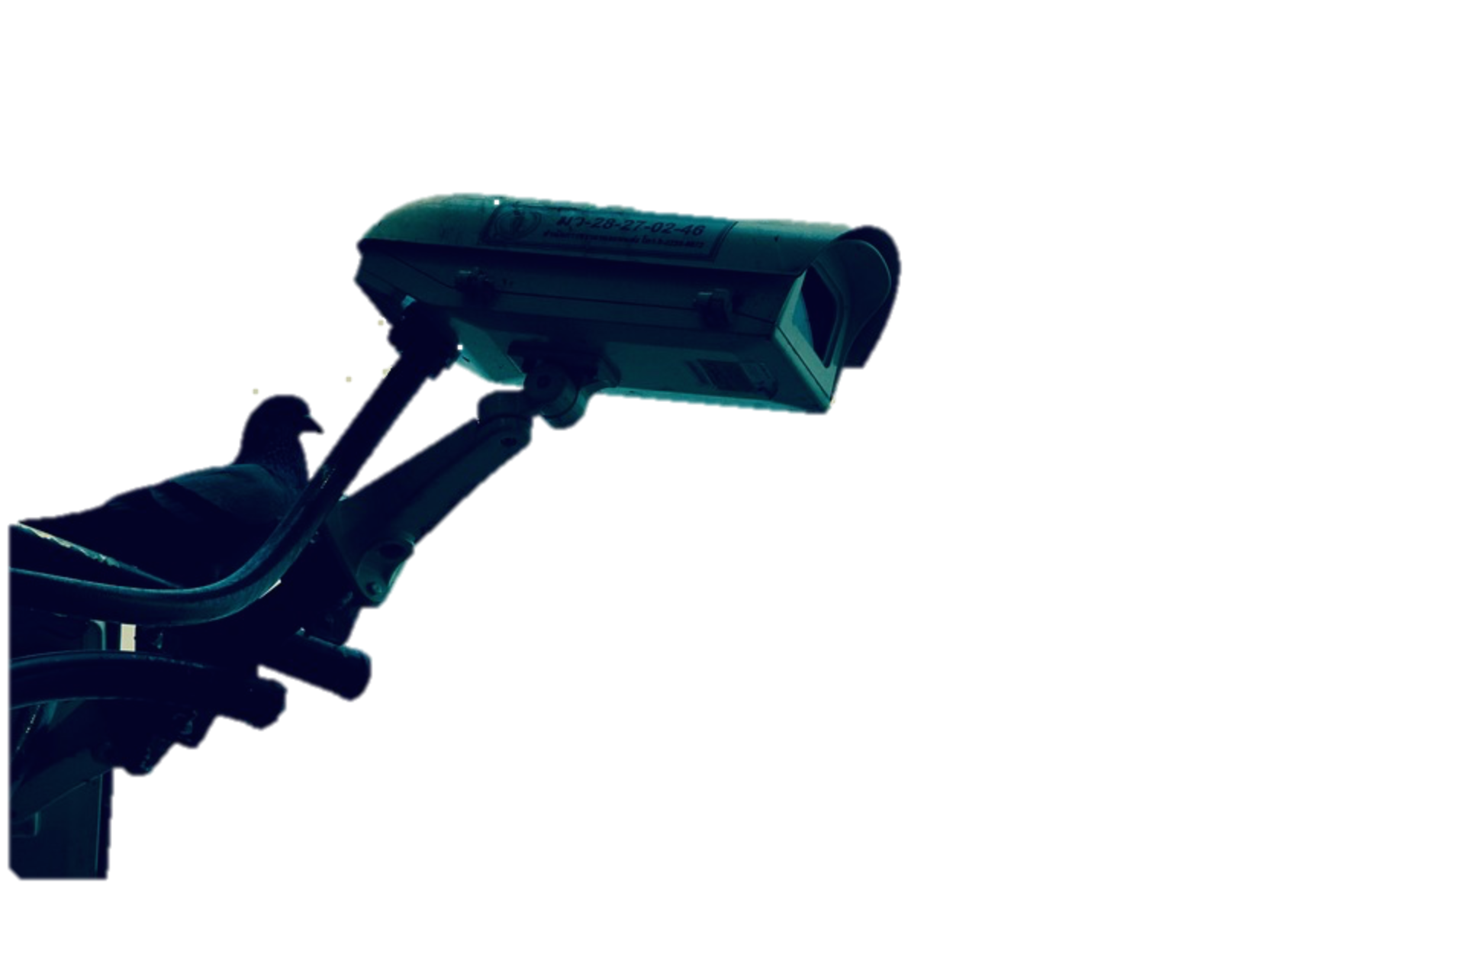
BACKGROUND
After a crime, police may have to follow the path of the criminal.
Difficulties : Too many cameras
Low quality of videos
Identify an individual in a crowd

Slide 6
BACKGROUND
Expensive process requiring a great deal of human resources.
Solution:
Automating the face recognition process in surveillance video

Slide 7
Problem Statement
Best results in face recognition with deep learning.
FaceNet (2015) reaches a 99.63% accuracy on“LFW” dataset for identification.
Goal: to build a deep neural network for face recognition on surveillance videos. Model based on the latest deep learning algorithms

Slide 8
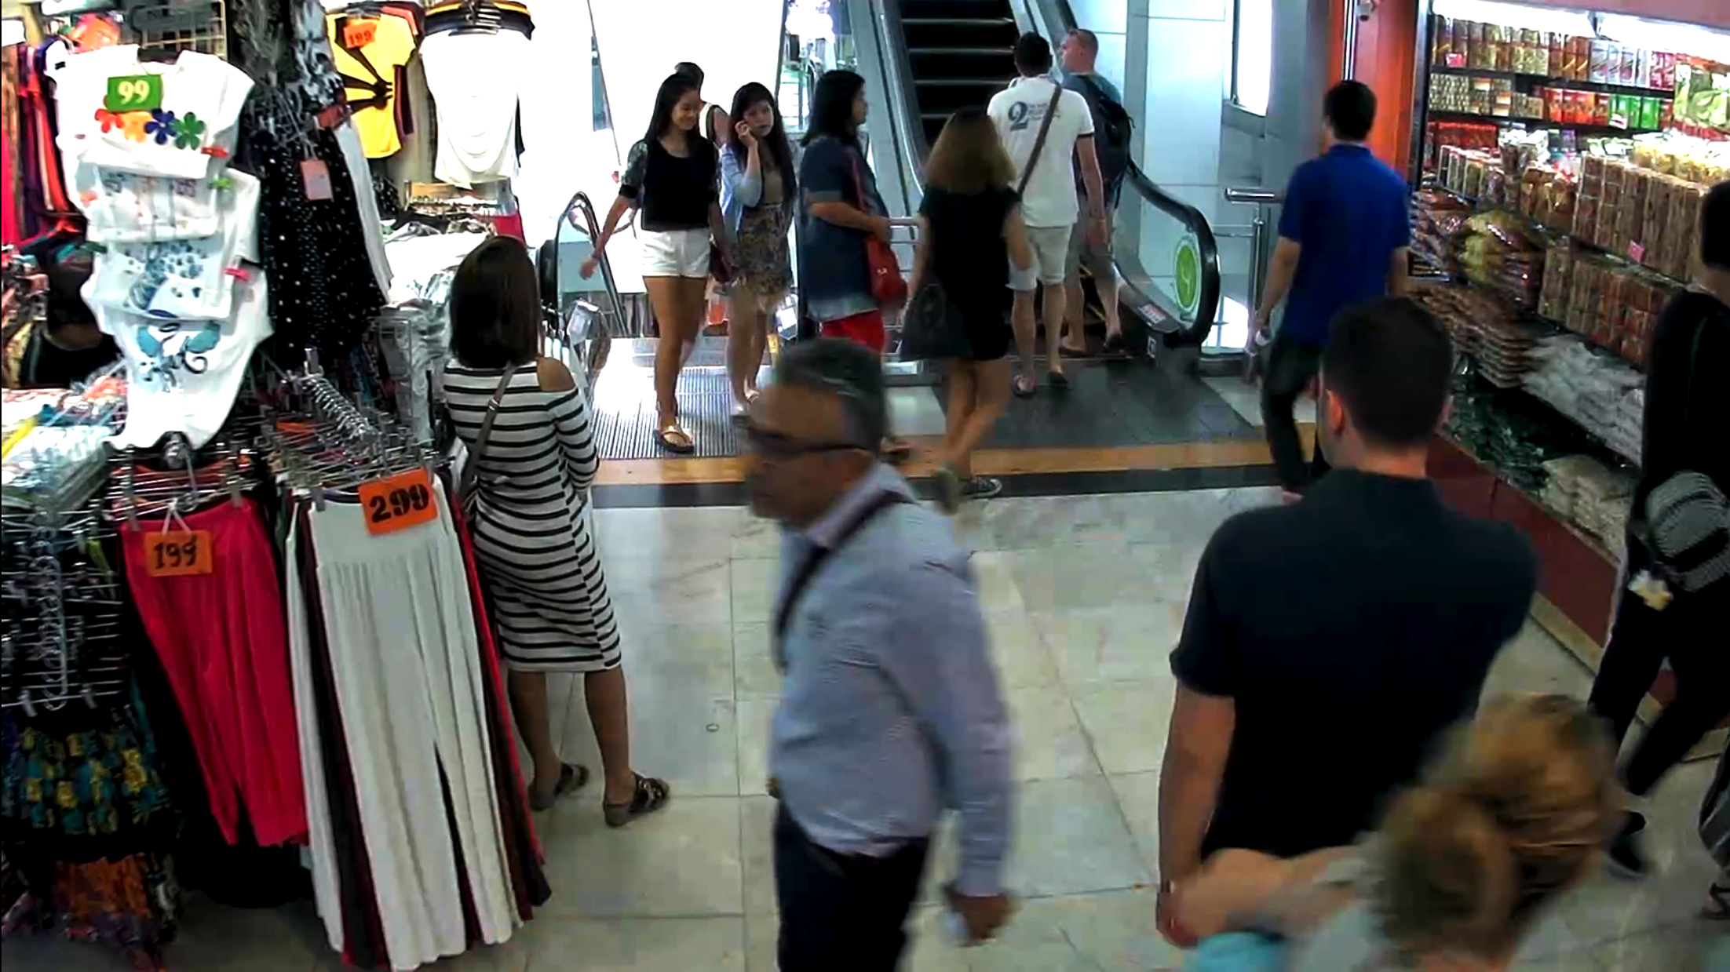
Objectives
A database contains recorded videos from the surveillance camera network at the MBK shopping mall in Bangkok.
Notes:
----- Notes de la réunion (3/21/16 07:56) -----
Database already provided.
Contains recorded videos from surveillance camera network at the MBK shopping mall in Bangkok.

Slide 9
Literature Review

Slide 10

Deep Learning
In « Deep learning methods and Applications »: « Deep learning is a set of algorithms in machine learning that attempt to learn in multiple levels, corresponding to different levels of abstraction. It typically uses artificial neural networks. »
Representation extracted from cs231n.gitub.io

Slide 11
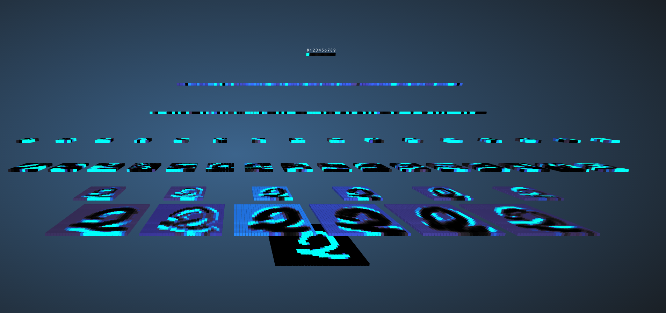
Convolutional Networks
Connect only adjacent neurons of a layer to the next one, whereas, standard layers connect all the neurons of a layer to the next one.
A subsampling of the convolutional layer is applied
Finally, generally, standard fully-connected layers.
Notes:
----- Notes de la réunion (3/21/16 08:06) -----
Don't go too much in the details here because the next slides do this job.

Slide 12
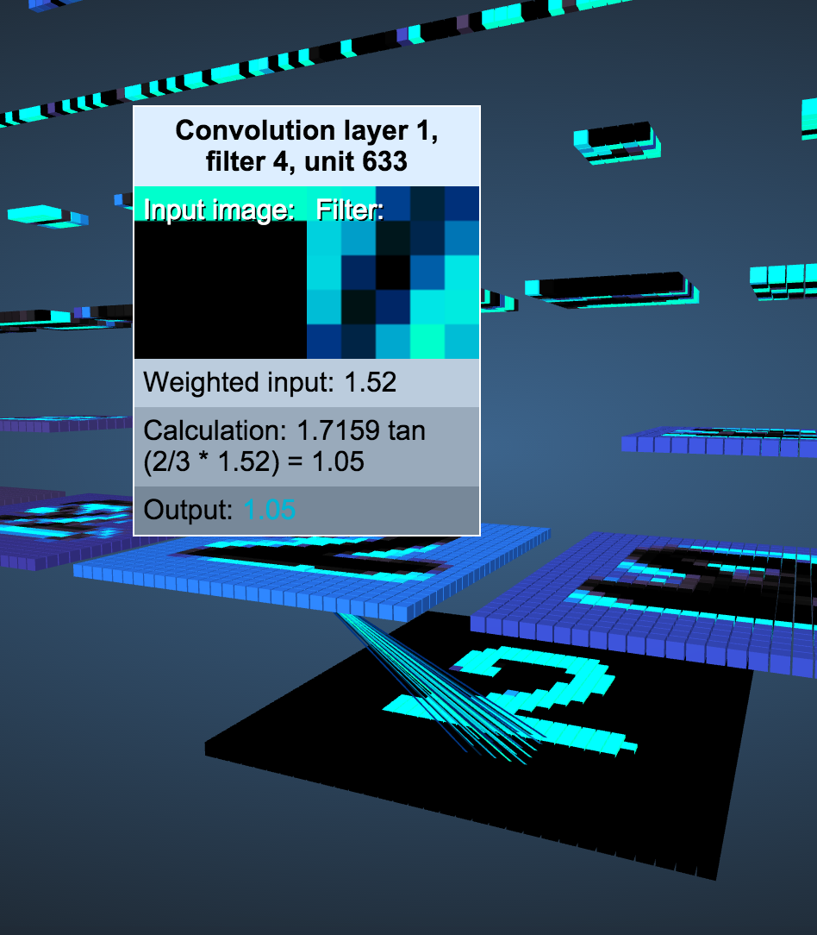
Convolutional Networks
Connect only adjacent neurons of a layer to the next one, whereas, standard layers connect all the neurons of a layer to the next one.

Slide 13
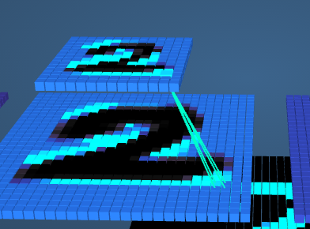
Convolutional Networks
Then, a subsampling of the convolutional layer is applied .

Slide 14
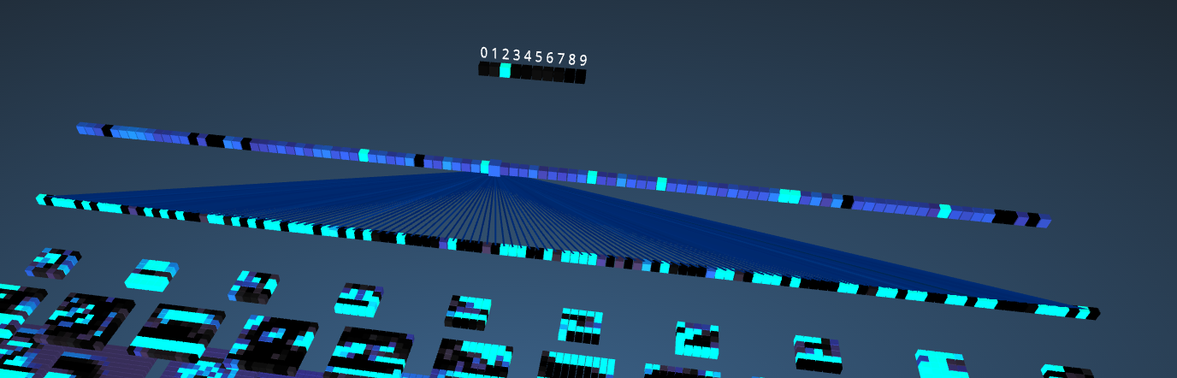
Convolutional Networks
Finally, standard fully-connected layers are applied.

Slide 15
DL for face recognition: Two main methodologies
Recognition by person identification. A network takes an image as an input and returns a label that identifies one and only one person as an output.
Recognition by comparison or verification. A network takes a pair of images as an input and “1” if they represent the same object — in our case, the face of a person — and “0” otherwise.

Slide 16
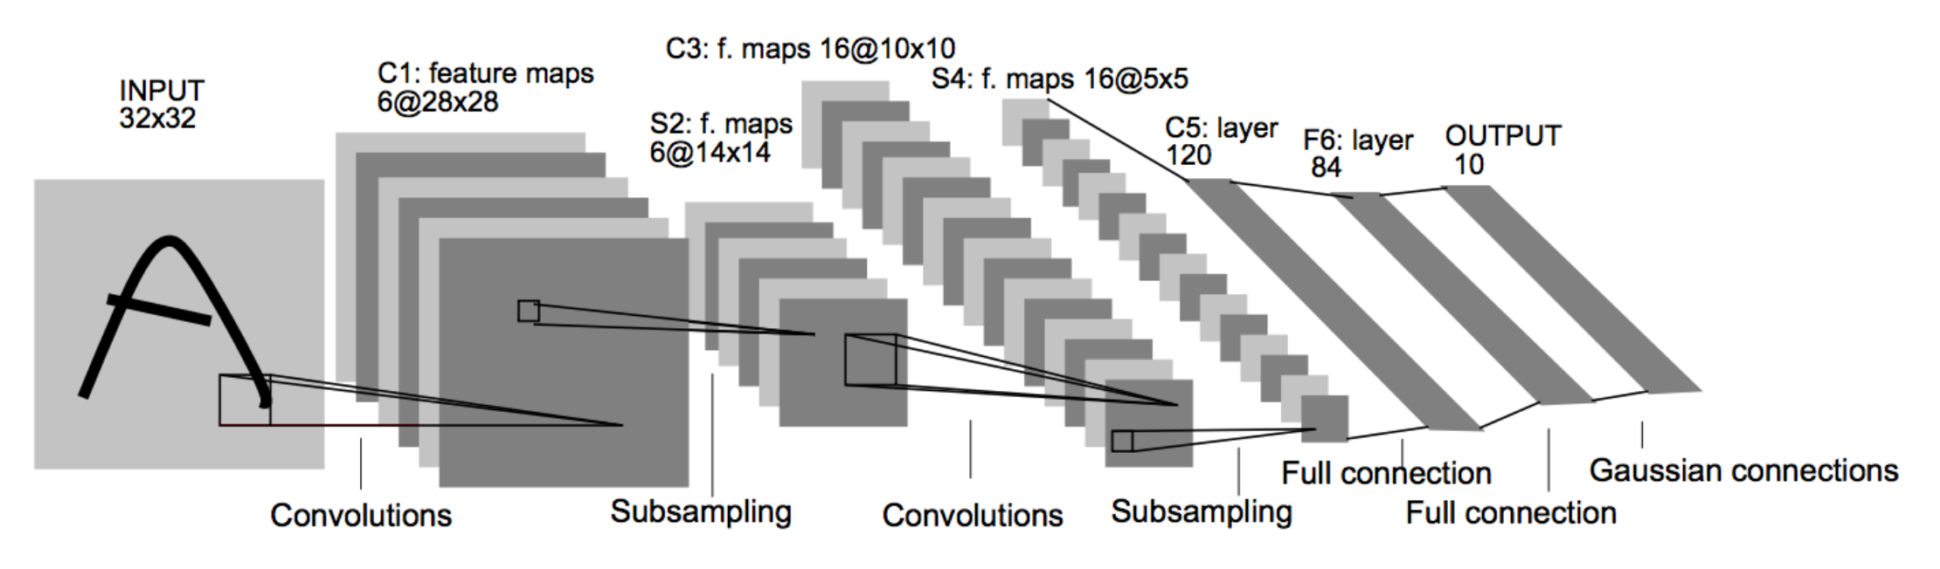
Recognition by person identification

Slide 17
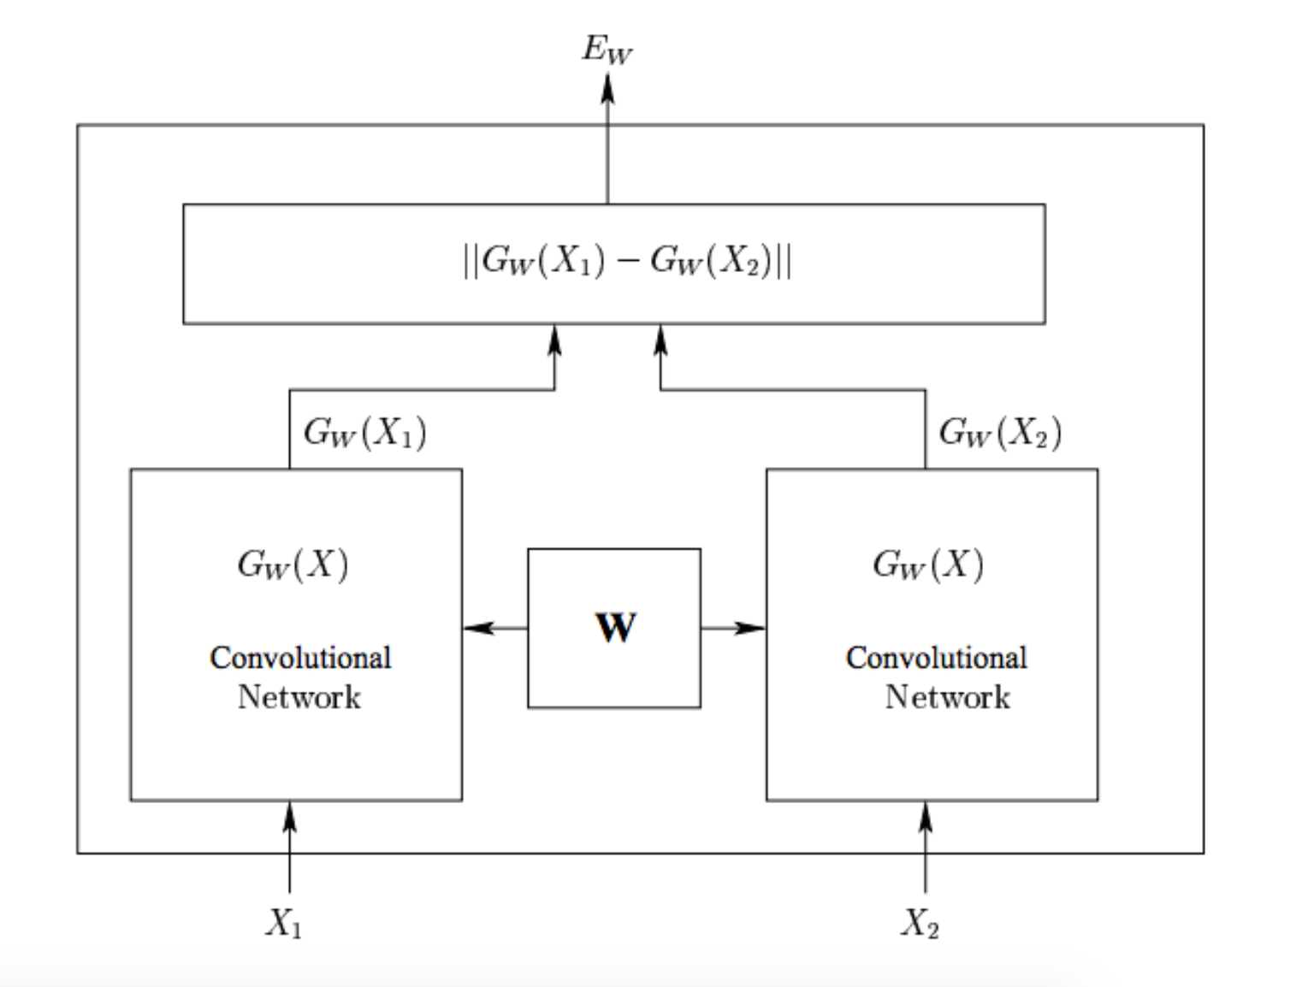
Recognition by comparison

Slide 18
Methodology

Slide 19
Design of the final product

Slide 20
Solution Design

Slide 21
Database
The database used is a set of 14 videos recorded in the MBK Shopping Center of Bangkok.
Duration of the videos is variable, from a minute to around 3 minutes and 30 seconds.
Three of the researchers of our laboratory appear in the videos, walking in the mall like any other person.

Slide 22
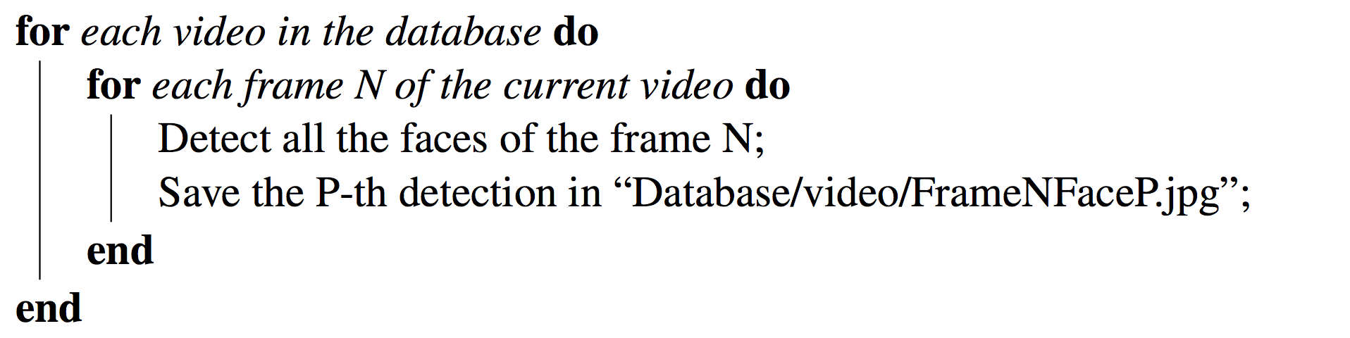
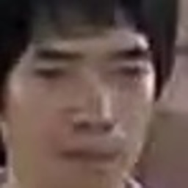
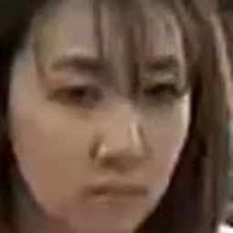
Raw Database of faces

Slide 23
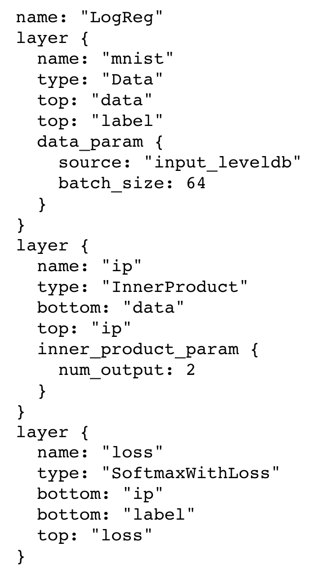
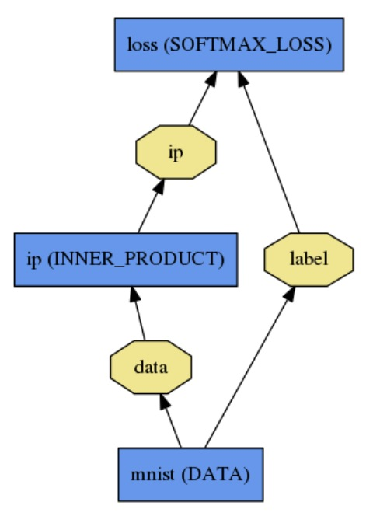
Caffe

Slide 24
Results

Slide 25
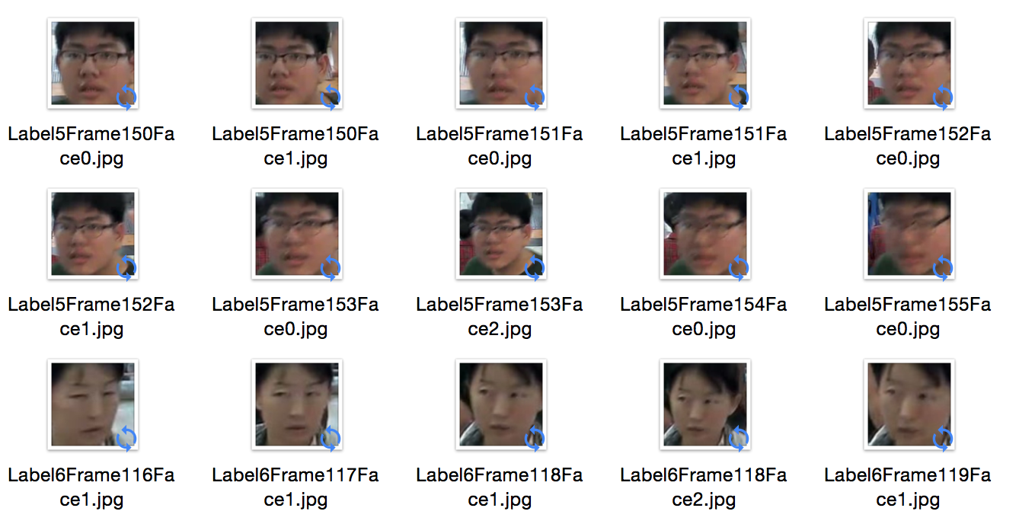
Improvement of face detection: face tracking
A face tracking algorithm was written to give a label to each picture.

Slide 26
Face tracking and Siamese Network
This algorithm was interesting to train a Siamese Network which requires a large number of labels with few pictures for each one.
Trained a Siamese Network.
Wrote a python script to interpret the results: The network could not converge.

Slide 27
Decision to work with another network
Studied another network.
The idea was to test the MBK database on a pre-trained network on which the data could be directly used with only minor modifications.
A particularly light and efficient “Same/Not Same” —or face verification— network which reached state-of-the-art results in November 2015 was selected.

Slide 28
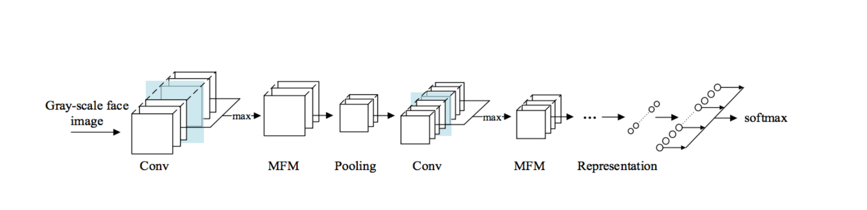
Architecture of the Lightened CNN
4 convolution layer with Max-Feature-Map activation functions, 4 max-pooling layers and 2 fully connected layers.

Slide 29
Results obtained on the MBK Database
The database: faces extracted from surveillance videos in the MBK mall in Bangkok. The labeling of the faces is done both through automatic overlapping and manual labeling for the researchers. This leads to around 85,000 images of faces.
Few mistakes were made by the automatic process and it was not feasible to correct them.
Test: 13881 negative pairs and 13881 positive pairs.

Slide 30
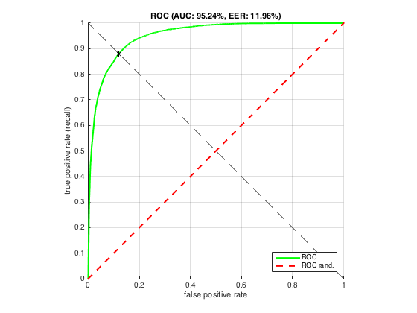
Results obtained on the MBK Database

Slide 31
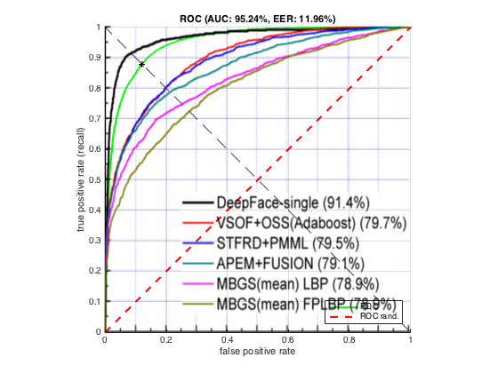
Results obtained on the MBK Database

Slide 32
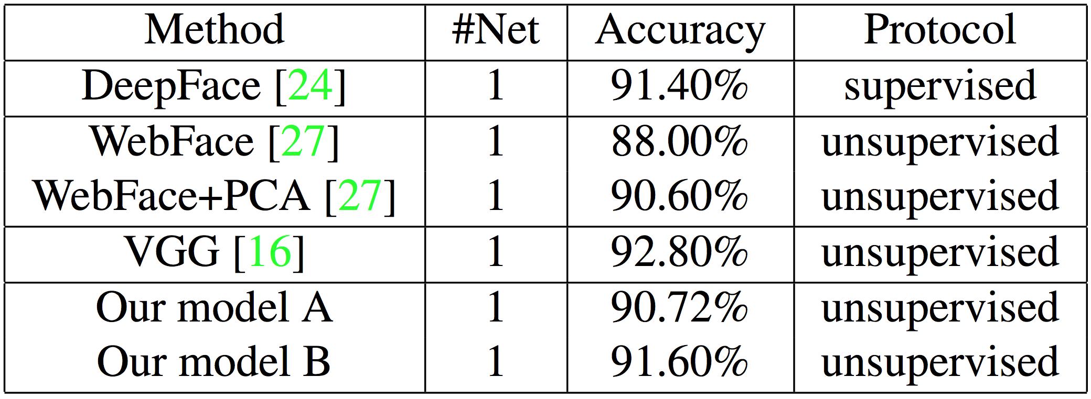
Results obtained on the MBK Database
In terms of accuracy, the lightened CNN on MBK Database reaches 88.04%

Slide 33
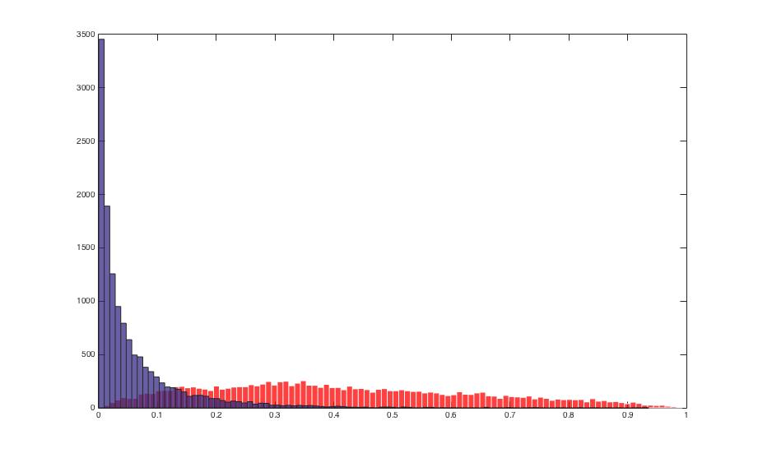
Results obtained on the MBK Database
Negative pairs in blue and positive ones in red. Few errors on the automatic process of overlapping were made.
Number of pairs considered as positive with low score slightly overestimated and number of pairs considered negative with high score slightly underestimated.
Hence the global accuracy is slightly underestimated.

Slide 34
Final Result
The final experimental software is made of:
A face tracker that extracts and label all the faces of the videos.
The face verifier that declares whether a group of face images categorized under a label represent a person the user is looking for or not.

Slide 35
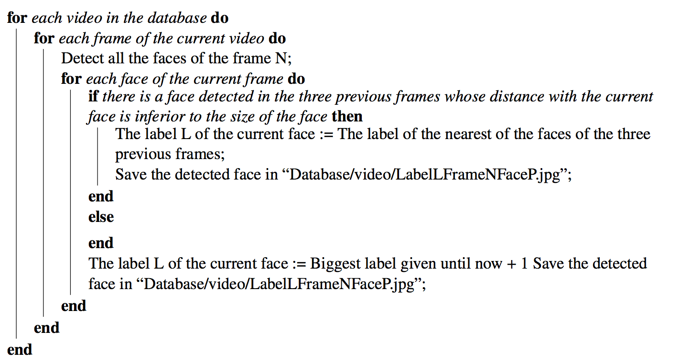
Face Tracker

Slide 36
Face Tracker

Slide 37
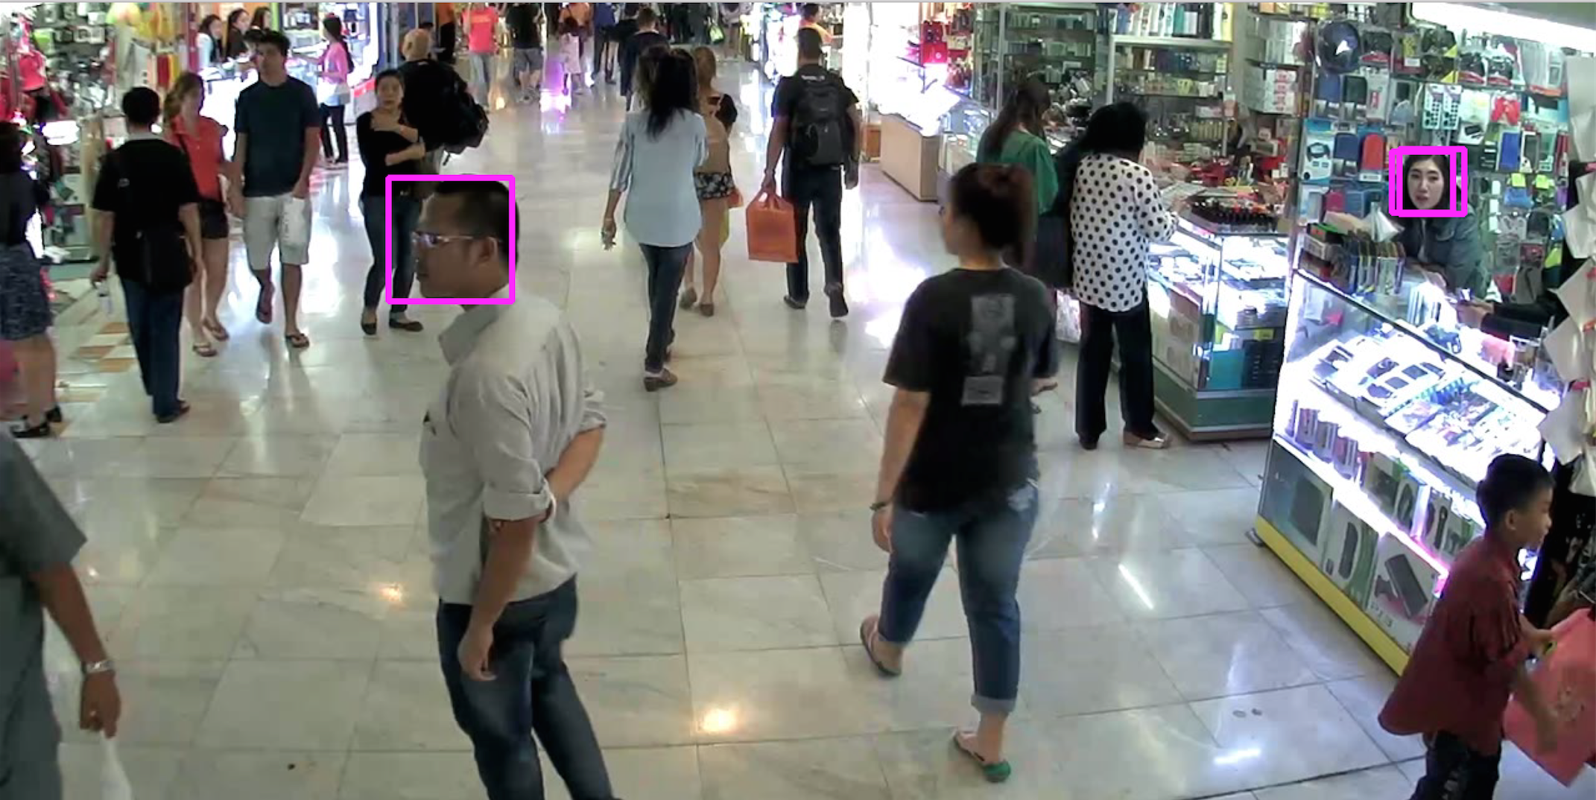
Face Tracker

Slide 38
Face Verifier
Asks the user to enter the address of the images of the person he is looking for in the database.
Process those images in the neural network that outputs an array of features (numbers) from each image.
Asks for the address of the database containing the images of face.
The array of features of each image is computed. The distance between each image of a detected face and each image of the person the user is looking for is computed. The algorithm decides whether it represents the same person or not.

Slide 39
Making the right decision
There are different ways to decide whether or not a group of same labeled face images are representing the person the user is looking for or not.
Method implemented: based on a matrix deciding for the best test to do. Details on the report.
Other method: law of large numbers. The total number of positive tests divided by the total number of tests will converge to the accuracy if the suspect is the criminal and to 1-accuracy else.

Slide 40
Conclusion

Slide 41
Conclusion
Goal reached: Built an algorithm which can detect our three researchers in the surveillance videos of a mall.
Possible improvements:
Use a better face tracker to limit the number of false positive images. The neural network has an unpredictable behavior when the input is not a face.
By using a better face detector like provided by the library dlib.
And by using a better algorithm to follow a face like SHIFT.

Slide 42
Conclusion
Other improvement: Implement the law of large numbers to make the best decision possible when an important number of images have to be compared.

Slide 43
Conclusion
The whole code is freely accessible on GitHub at this address: http://github.com/Paul-Darius/ait-research-study-finished

Slide 44
Thanks for your time!

